Slide 1


Stay Safe Online with
Bee-Bots, Snakes & Ladders!

Slide 2


Slide 3

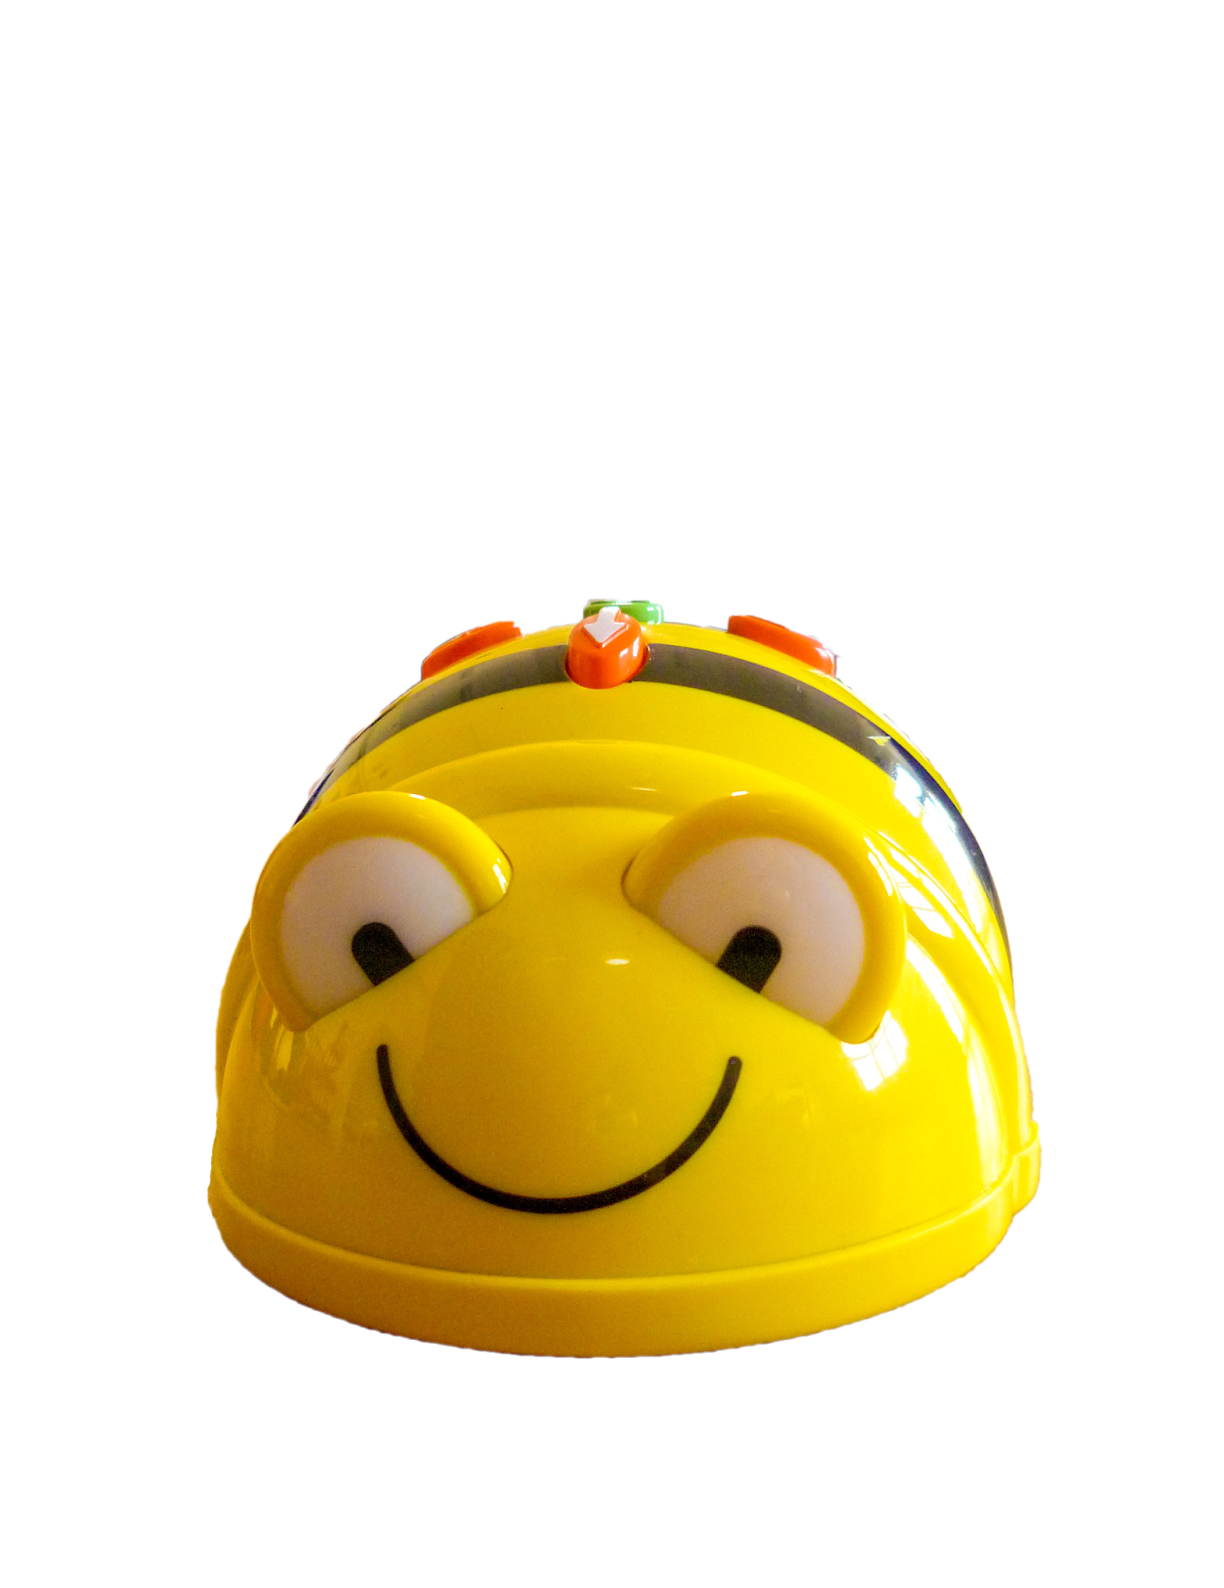


Today we are learning about:
Programming & Online Safety
I can write an algorithm
I can program a Bee-Bot
I can debug an algorithm
and a program
I know and understand
a range of online safety
dos and don’ts

Slide 4
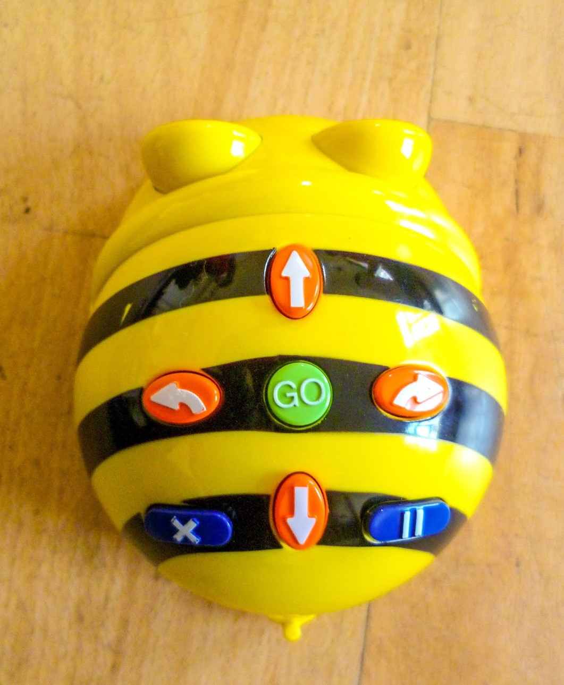
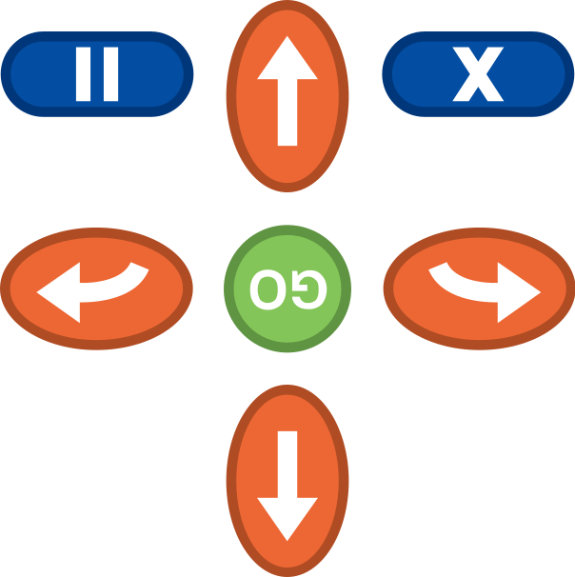

Recapping:
Programming Bee-Bots
What commands can we use?
What do they do?
How can we draw these commands on
our whiteboards?
(Linking to our algorithm recap on the next slide)
FORWARDS
TURN
LEFT
TURN RIGHT
CLEAR
PAUSE
BACKWARDS

Slide 5

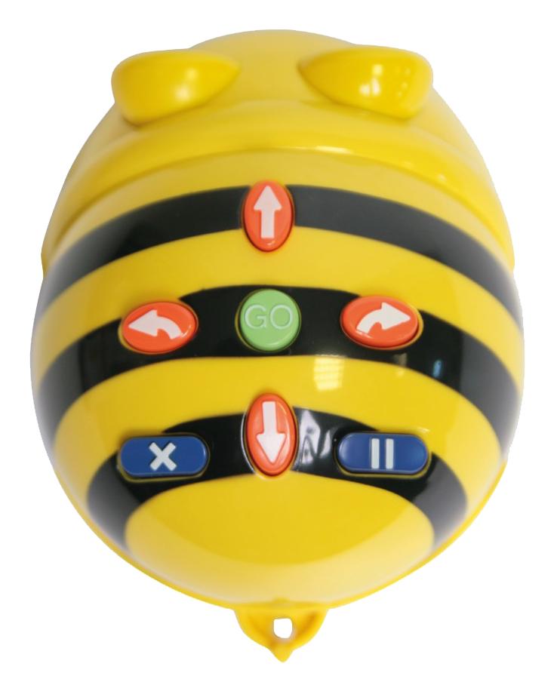
Recapping Algorithms
Before coding our Bee-Bot, we write the algorithm for the commands we will use on our whiteboards, like the example in the picture below. This gives us a chance to test out our algorithm with a fake bot to check it is correct.
Can you work out which square the Bee-Bot on the board below will end up on if it follows this algorithm?
Where does this algorithm
move the Bee-Bot to?
Top tip:
Remember algorithms are for
humans, not computers. So you can write
them however you want, using arrows, words, letters or signs

Slide 6
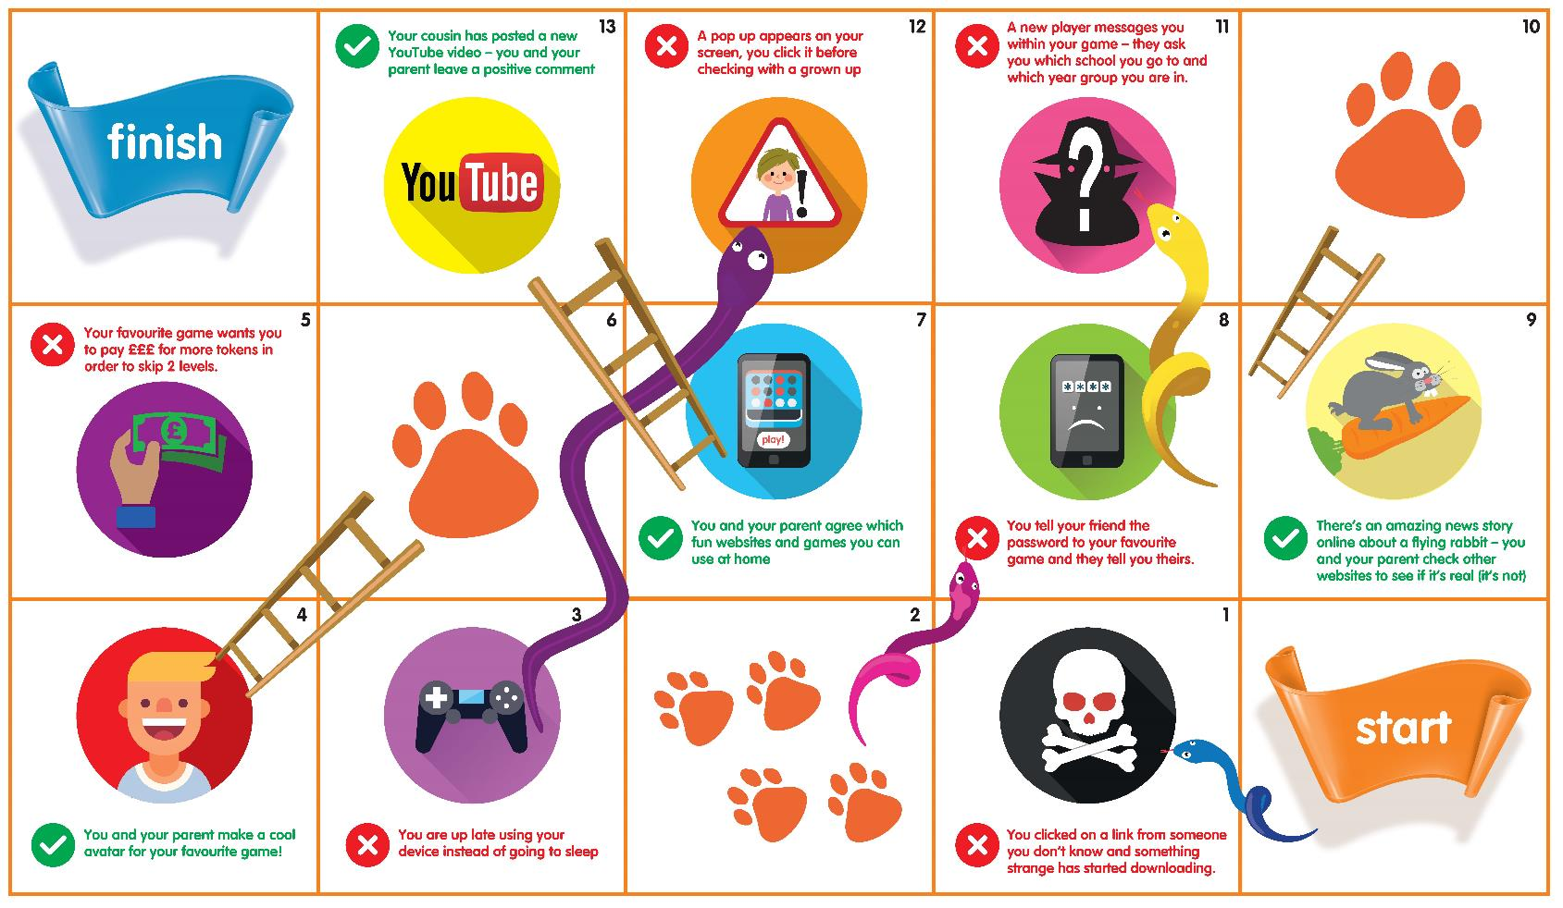
Bee-Bots, Snakes & Ladders - the rules!
1.
Roll a dice to work out where your Bee-Bot
should land (including going up ladders or
down snakes!)
2.
Write the algorithm for your Bee-Bot to get
to that square on your whiteboard. Test your algorithm with a fake bot and debug if needed!
3.
Code your Bee-Bot and run the code to see
if your Bee-Bot moves to the correct square.
4.
If it lands on the correct square you can stay there. If your code was wrong, go back to the square you were on. If you were supposed to land on a snake, you still have to move your
Bee-Bot to the end of it!
5.
If you land on an online safety ‘Do or Don’t’
tip, share this with your partner and discuss why it is or is not a good idea.

Slide 7
Today we are learning about:
Programming & Online Safety
I can write an algorithm
I can program a Bee-Bot
I can debug an algorithm
and a program
I know and understand
a range of online safety
dos and don’ts

Slide 8





Bee-Bots, Snakes & Ladders (online version)
Click on the commands you
wish to enter in your program
then press ‘GO’
To reset the Bee-Bot and clear commands please press ‘X’
1.
2.

Slide 9
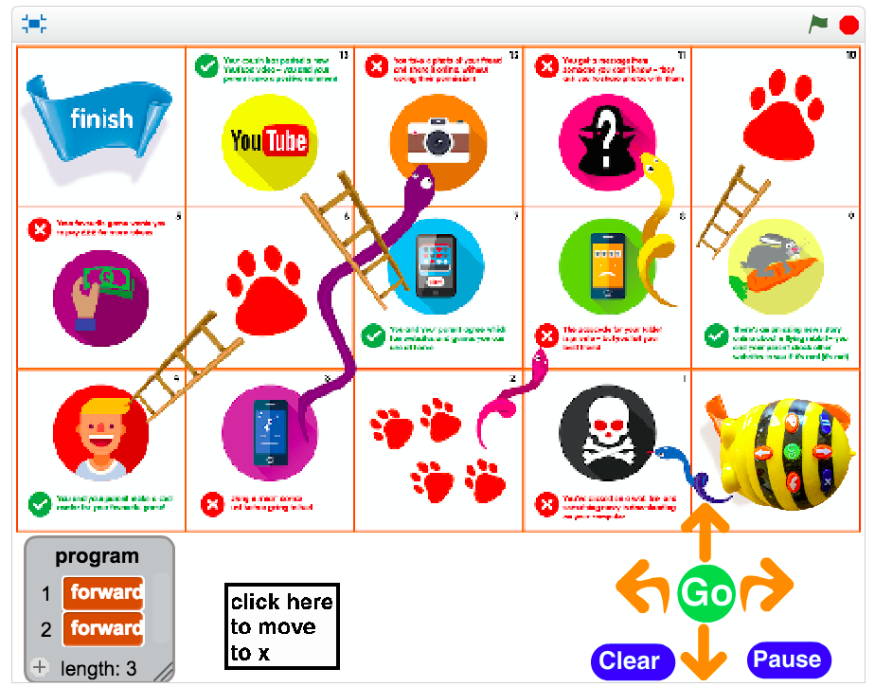
Bee-Bots, Snakes & Ladders (online version)
You will see the commands
in your program appear here
2.

Slide 10
Bee-Bots, Snakes & Ladders (online version)
Click ‘Go’ to run your program
and watch your Bee-Bot move
3.

Slide 11
Bee-Bots, Snakes & Ladders (online version)
Notice we cleared our program after each turn
4.

Slide 12
Stay Safe Online with
Bee-Bots, Snakes & Ladders!

